Slide 1
C#

Slide 2
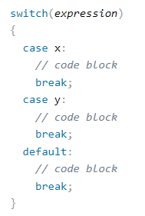
Switch Statements
Use the switch statement to select one of many code blocks to be executed.
The switch expression is evaluated once
The value of the expression is compared with the values of each case
If there is a match, the associated block of code is executed
The break and default keywords will be described later in this chapter

Slide 3
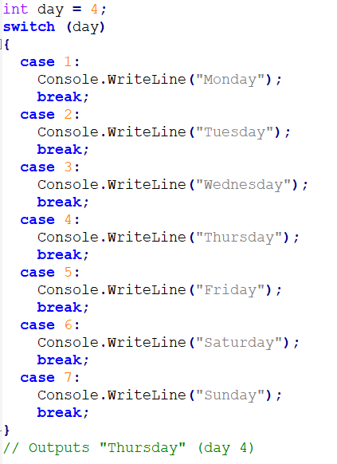

Slide 4
The break Keyword
When C# reaches a break keyword, it breaks out of the switch block.
This will stop the execution of more code and case testing inside the block.
When a match is found, and the job is done, it's time for a break. There is no need for more testing.
A break can save a lot of execution time because it "ignores" the execution of all the rest of the code in the switch block.

Slide 5
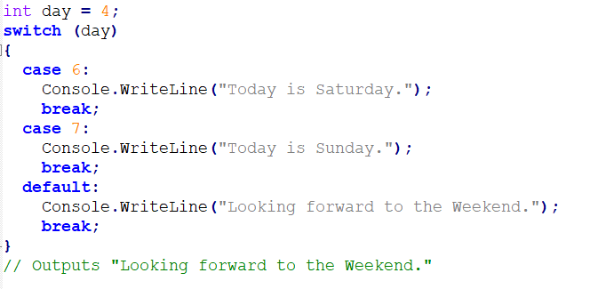
The default Keyword
The default keyword is optional and specifies some code to run if there is no case match:

Slide 6
Loops
Loops can execute a block of code as long as a specified condition is reached.
Loops are handy because they save time, reduce errors, and they make code more readable.

Slide 7
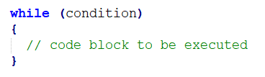
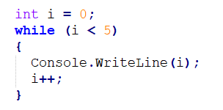
While Loop
The while loop loops through a block of code as long as a specified condition is True:
In the example below, the code in the loop will run, over and over again, as long as a variable (i) is less than 5:

Slide 8
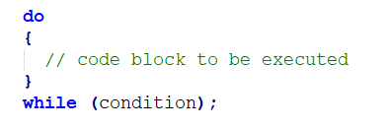
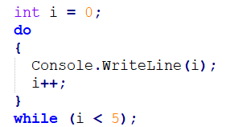
The Do/While Loop
The do/while loop is a variant of the while loop.
This loop will execute the code block once, before checking if the condition is true, then it will repeat the loop as long as the condition is true.
The example below uses a do/while loop. The loop will always be executed at least once, even if the condition is false, because the code block is executed before the condition is tested:

Slide 9
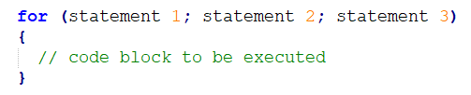
For Loop
When you know exactly how many times you want to loop through a block of code, use the for loop instead of a while loop:
Statement 1 is executed (one time) before the execution of the code block.
Statement 2 defines the condition for executing the code block.
Statement 3 is executed (every time) after the code block has been executed.

Slide 10
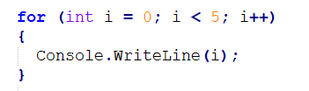

For Loop
The example below will print the numbers 0 to 4:
This example will only print even values between 0 and 10:

Slide 11
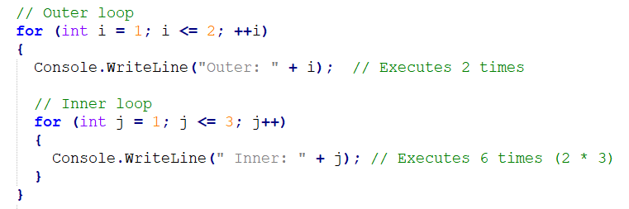
Nested Loops
It is also possible to place a loop inside another loop. This is called a nested loop.
The "inner loop" will be executed one time for each iteration of the "outer loop":

Slide 12
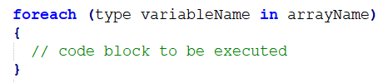
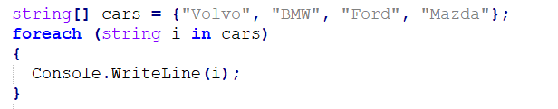
Foreach Loop
There is also a foreach loop, which is used exclusively to loop through elements in an array.
The following example outputs all elements in the cars array, using a foreach loop:

Slide 13
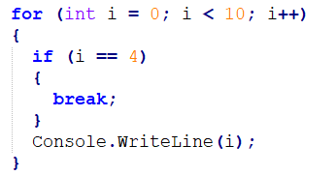
Break and Continue
The break statement can also be used to jump out of a loop.
This example jumps out of the loop when i is equal to 4:

Slide 14
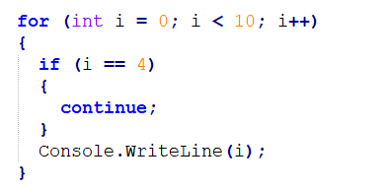
Break and Continue
The continue statement breaks one iteration (in the loop), if a specified condition occurs, and continues with the next iteration in the loop.
This example skips the value of 4:

Slide 15
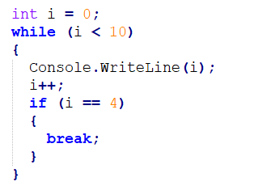
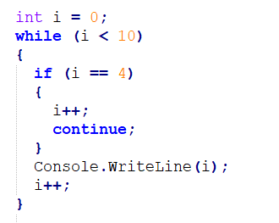
Break and Continue in While Loop

